Slide 1
HABIT, PRODUCTIVITY, and BEHAVIOR Change due to COVID

Slide 2
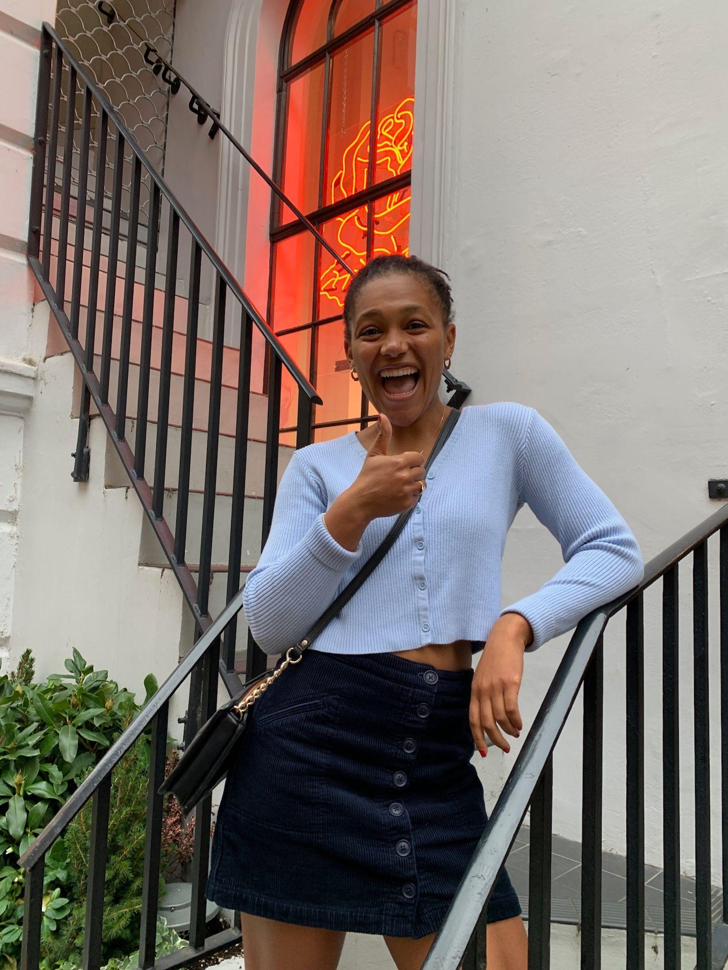
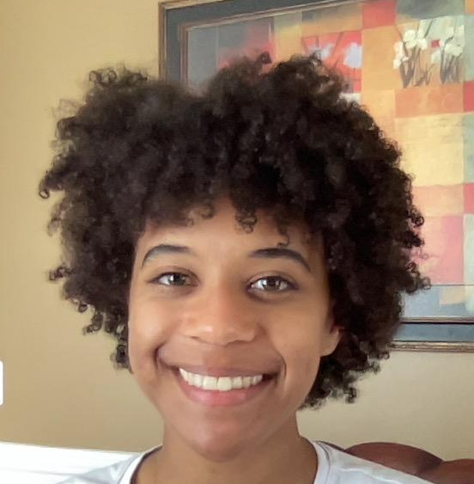
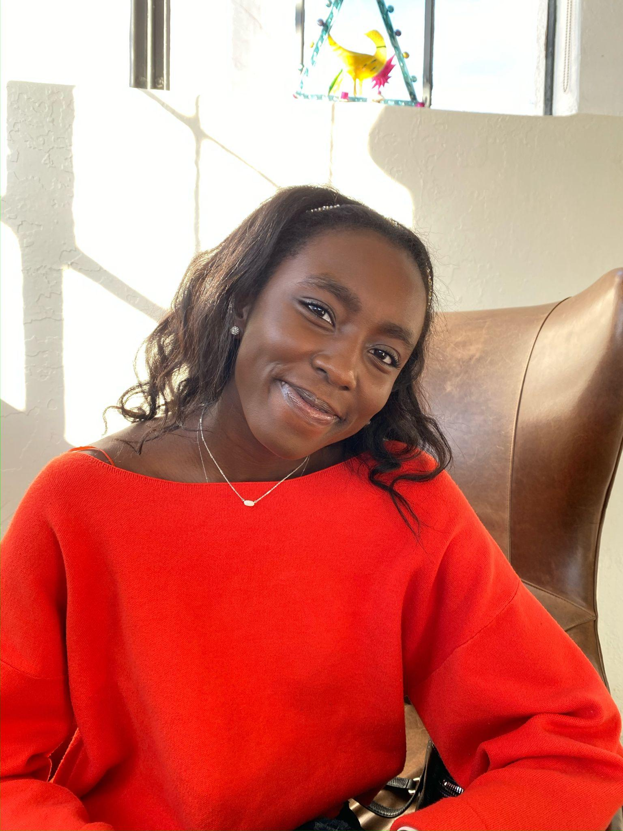
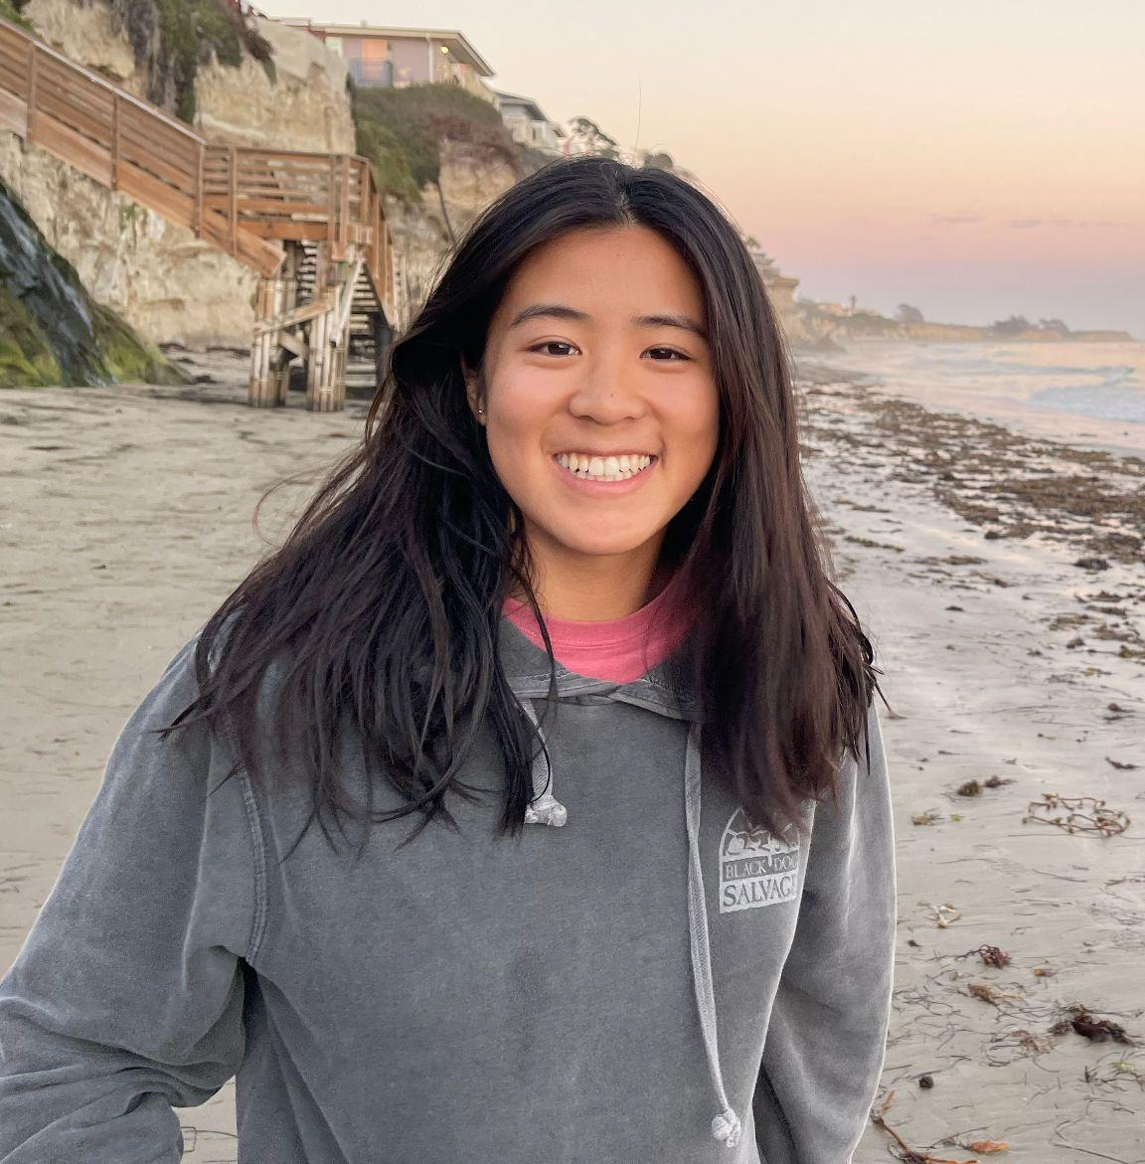
Intro
Theme
Kendall Titus
Taylore Givens
Problem Domain
Timi Adeniyi
Tiffany Lee
Productivity and Behavior Change
Habit, Productivity, and Behavior Change due to COVID

Slide 3
01
Needfinding Methodology

Slide 4
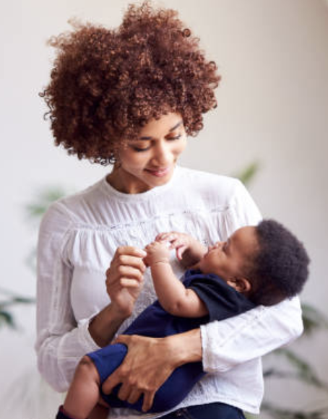
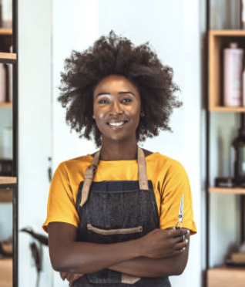


Our Participants
“Ella”
“Tamara”
“Maria”
“Grace”
Who: Mother, Software Engineer
Why: Mums daily habits
How: Timi’s relative
Where: Zoom
Who: Hair Stylist
Why: Working Woman
How: Taylore’s Hairstylist
Where: Zoom
Who: Professor
Why: Educator
How: PWR Professor
Where: Zoom
Who: Engineer
Why: Young female professional
How: alum
Where: Zoom

Slide 5
Interview Questions
Background
Ex. Tell me about yourself, walk me through a typical day.
Building Rapport
Ex. I’ve never [taught high school] before, how do you prepare for [class]?
Stories and Emotions
Ex. Tell me about the worst day you’ve had in the past 30.
Ex. The best?
Reflection
Ex. What has been most rewarding about [raising kids/teaching/hairstyling].
Notes:
Background
Walk me through your work day yesterday/What does your typical weekday look like?
What is the first interaction you have with technology?
Why did you use x technology at that time?
Stories and Emotions
How have your daily routine, behavior and habits changed since COVID started?
Are you working toward changing any of your habits, daily planning, and productivity habits/behaviors? If so, why and how.
Do you have any repetitive or monotonous tasks you don’t enjoy completing/wish you could do faster?

Slide 6
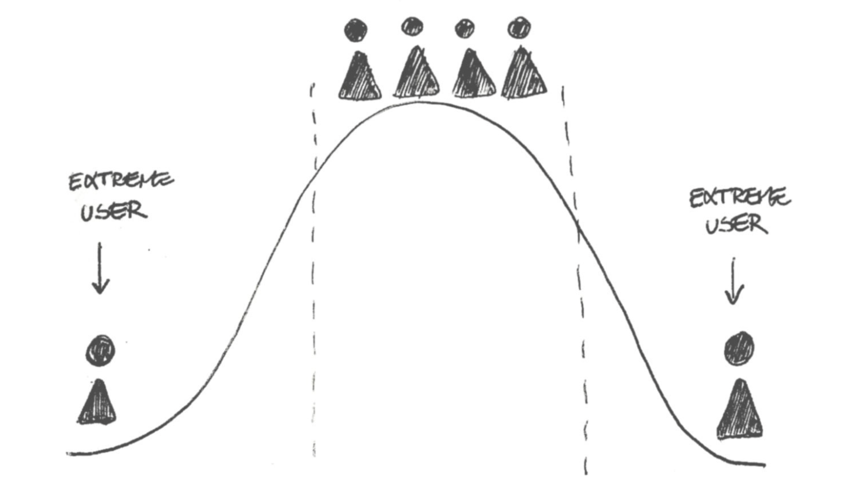
Extreme Users
Ella: Stay-At-Home Mom
productivity is “how can I best support my kid”
More routine/monotony for young kids
Productivity for self versus dependant toddlers
Notes:
Not productive in the traditional “work life” sense. “How much work can I complete today”...”How can I best support my kids today”
Focused on having more routine/monotonous days to provide stability for toddlers
The way she defined, Productivity, was less about herself… but more about being productive for others whose lives depend on her.
Optimizing her productivity, at the end of the day, is more directly related to making her kids lives better than her own.

Slide 7
02
Interview Results

Slide 8
“Ella”: Young Mother
“Since having kids it’s been really difficult, it was the first time in my life I’ve got a therapist”
“It’s hard but it is my choice”
“The hour in the car is the only time during day no one is talking to me”
“The best days are always outside and are the days you can’t be bothered”
“Everyday has to be productive.”
Notes:
“Everyday has to be productive. If I’ve picked them up, fed them, taken them to gym, it’s productive. There is no down time, and it feels like with little kids you are juggle a lot of things every day. Difficulty is because of the monotony and all the days mold into one”
“The hour in the car is the only time during day no one is talking to me. I usually get a coffee or sit in the car and put things in a calendar on my phone, look at emails and see what’s coming up next week, oh and listen to a podcast”
_________
Surprises:
Having time for the first time since working & university to take time for the arts and things she always wanted to do (taking a ceramics class)
With kids, everyday is so different and can change so much but they are so rewarding in a way that they teach you about yourself and make you question your beliefs
Surprises:
Inner child
Ceramics class
Rewarding in that they make you question yourself

Slide 9

“Maria”: Professor
“I don't eat meat, so I didn't share in what we ordered…I made toast”
“I got into a fight with the big kids about why they're not taking care of the dogs”
“Then the little dog escaped!”
“No one had thought of dinner, and I felt bad.”

Slide 10
“Grace” : Young Professional
“I usually don’t take lunch breaks”
“Lucky I don’t have kids right now. I can’t imagine what my life would be like with kids which is so far away”
“Work with people with kids right now and it’s so different… her kids negatively impact her productivity”
“I’m willing to give up sleep, because it’s unfair to only have an hour of personal time.”
Notes:
_____
Surprises:
More personal time WFH
A lot of time cleaning/cooking
Prioritizes weekend fun>commute

Slide 11
“Tamara”: Salon Owner and Stylist
“Shutting down for COVID gave me time to rest but it has been difficult”
“I started a women's empowerment group”
“I like to buy myself something nice a couple times a month ”
“I like reading a lot of self-help books and thinking positively
“It can be addicting, waking up and immediately scrolling on my phone.”

Slide 12
03
Empathy Maps & Analysis

Slide 13
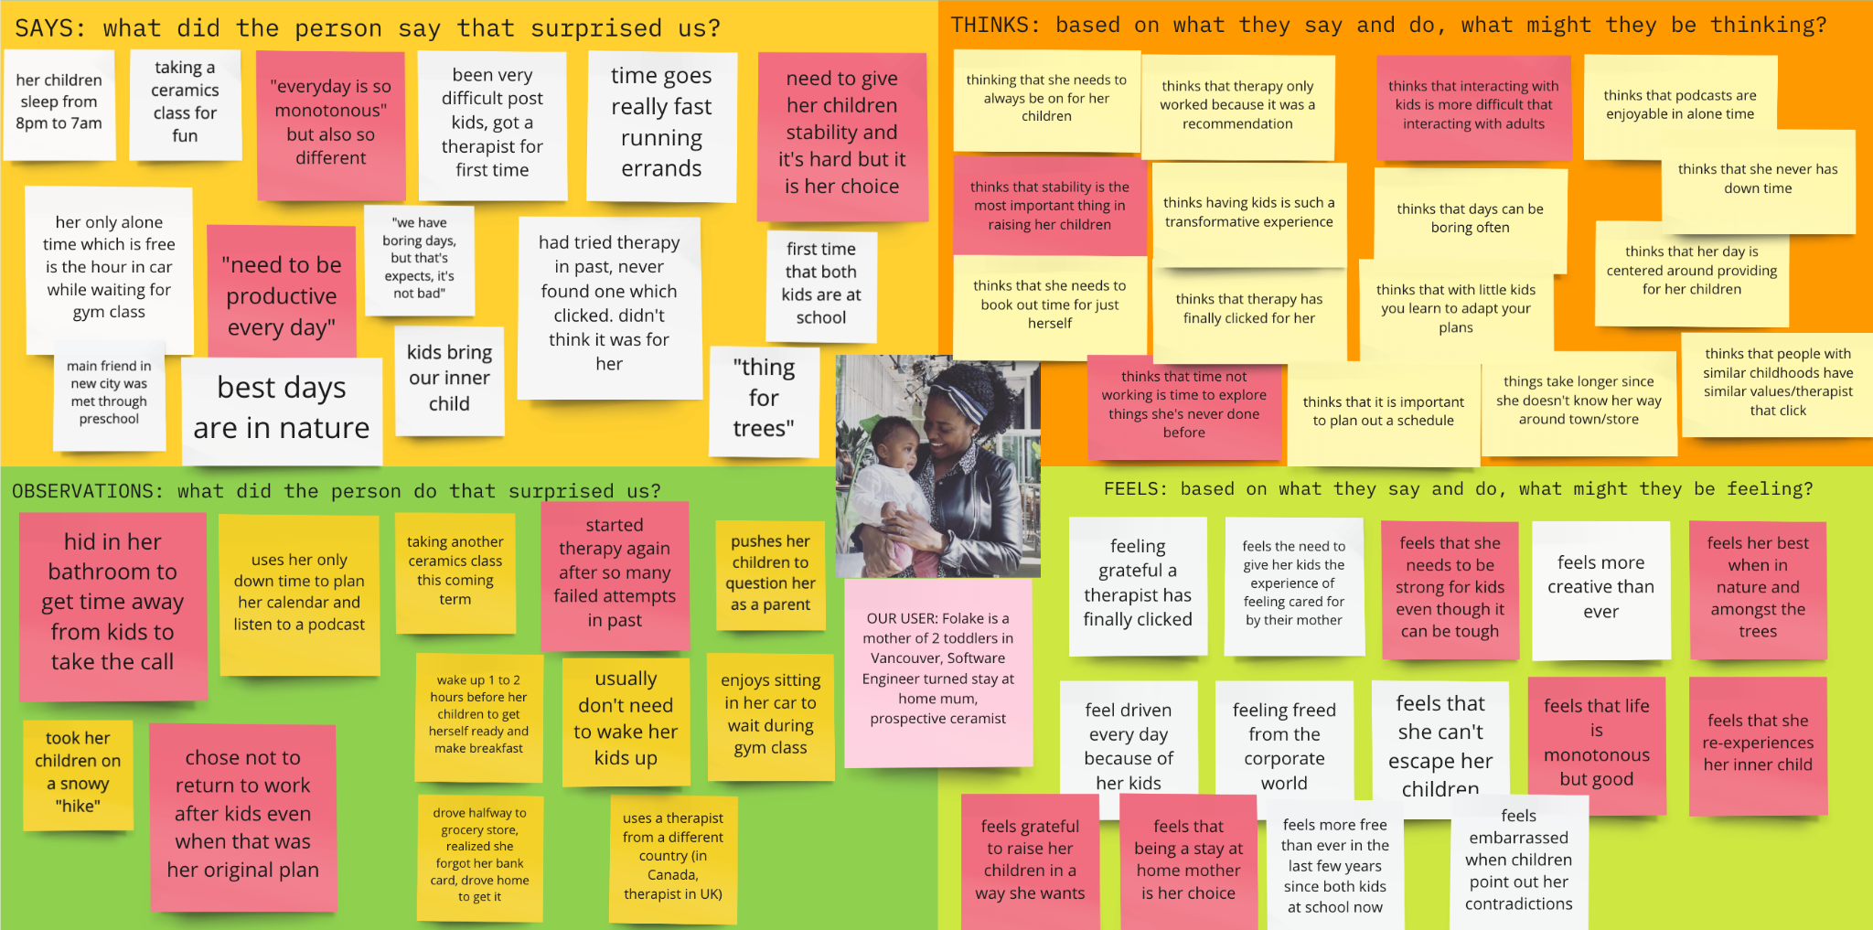
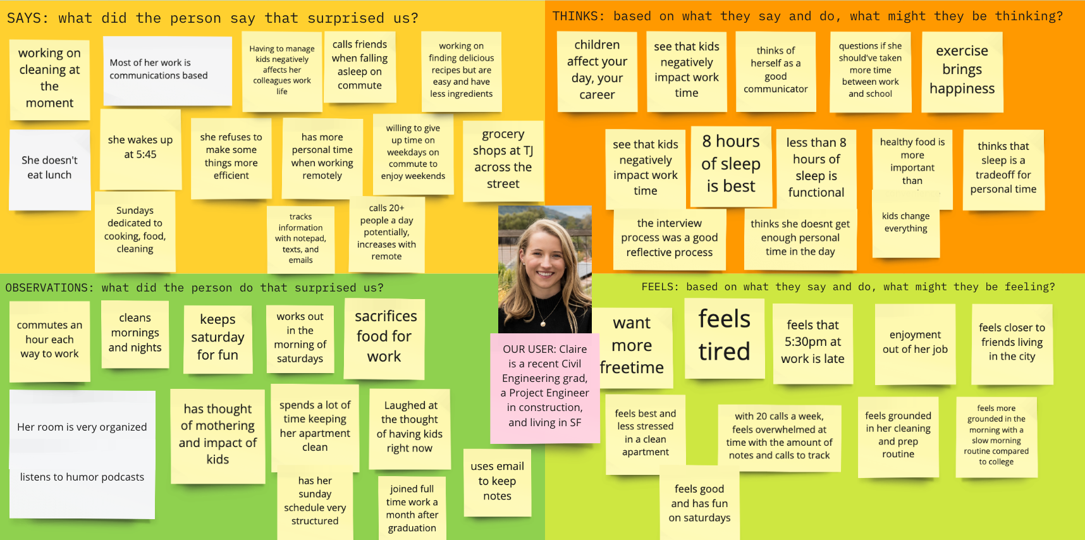
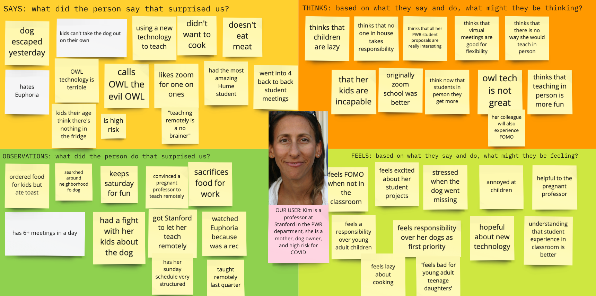
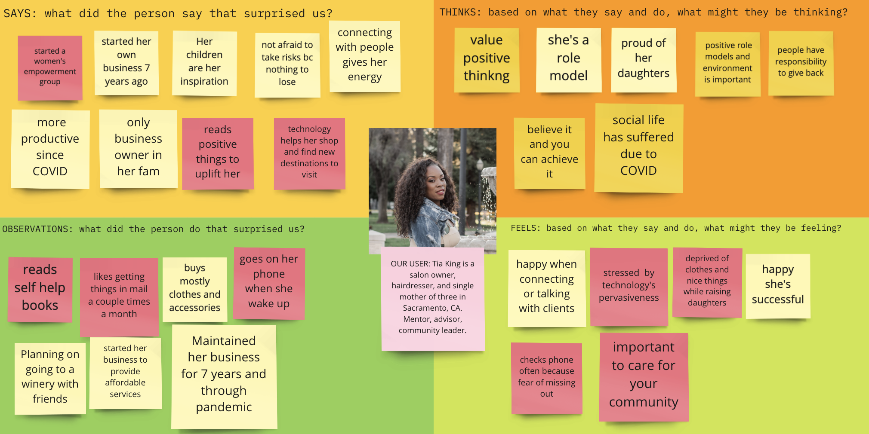
Empathy Maps

Slide 14
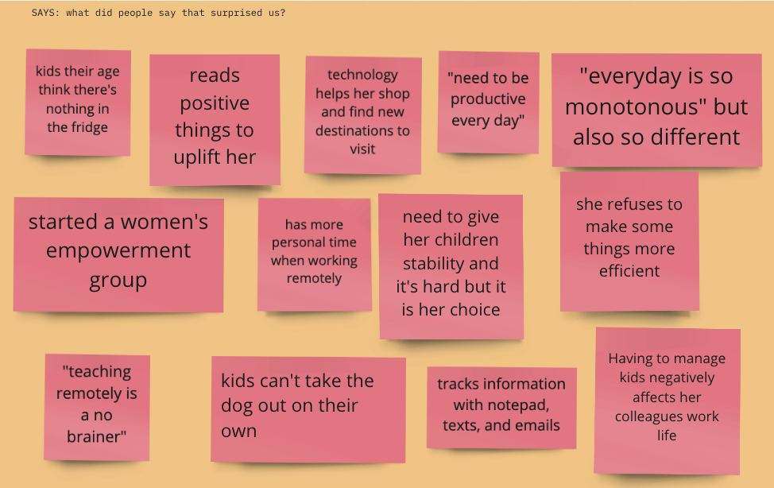
Notes:
A lot of these related to :
motherhood/children:(kids top left, need to give..children stability, started womens empowerment, kids can’t)
Personal time: (read positive things,
Technology interaction(technology,
Productivity (need to be productive, refuses to make,

Slide 15
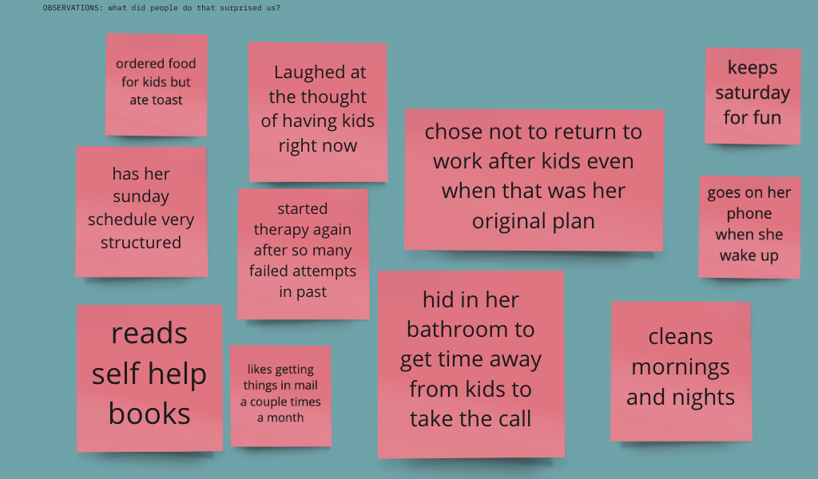
Empathy Map: Maria
Notes:
Kids overbearing
Sacrifice
Self-care
technology

Slide 16
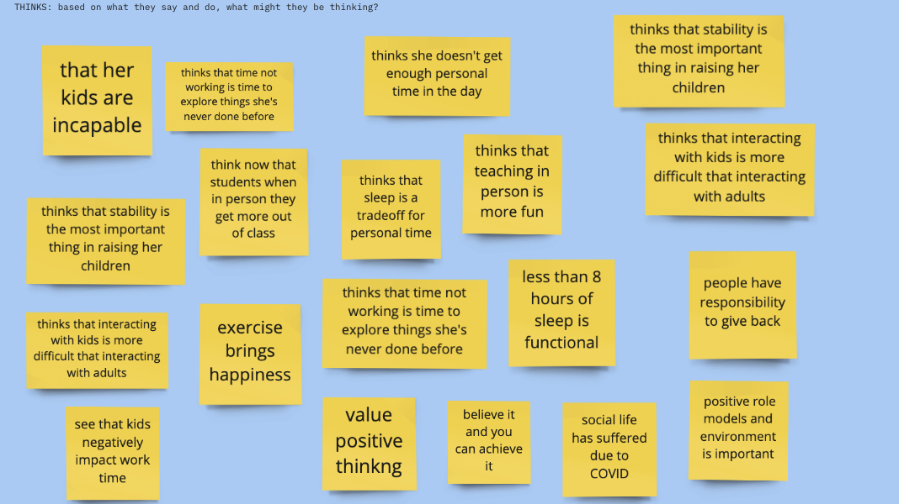
Empathy Map: Tamara
Notes:
Kids overbearing and challenging
Technology is nice/helps but not sufficient (social media spend a lot of free time on it but like human interaction, tech in classroom)
Positive thinking and taking time for yourself to do restorative things is important for health and succes
Stability and positive environment is important for qulity of life

Slide 17
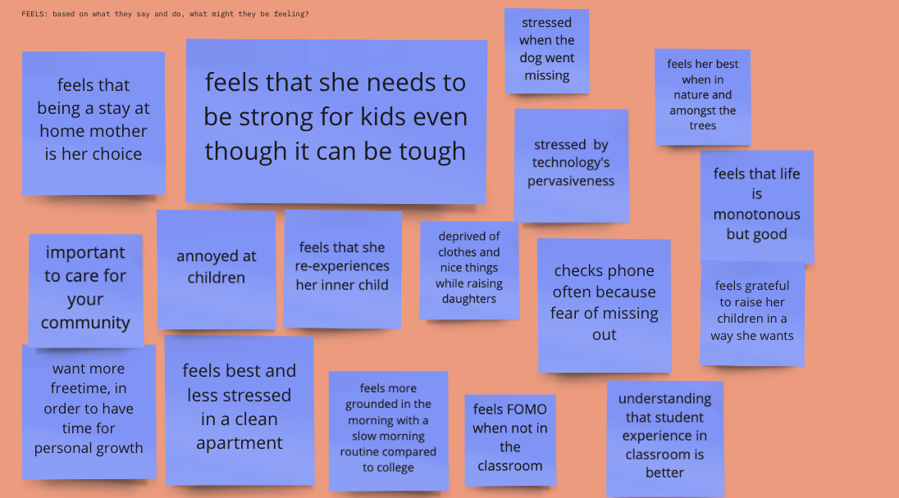
Notes:
-feel like they need to sacrifice, strong, and care for others and community
- FOMO with technology notifications, news and in person experiences
- like having unstructured free time helps them recharge and reclaim their day/life

Slide 18
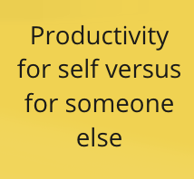
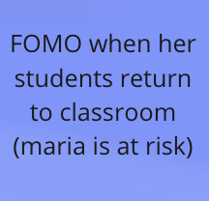
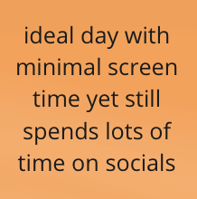
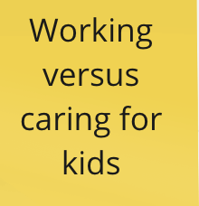
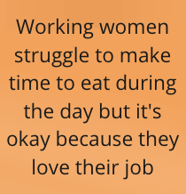
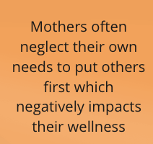
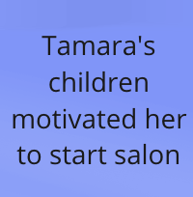
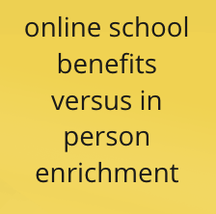
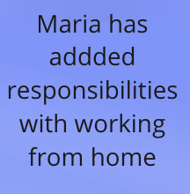
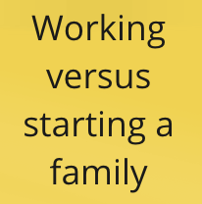
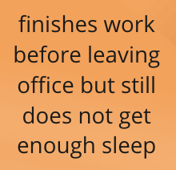
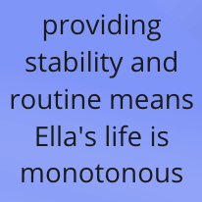
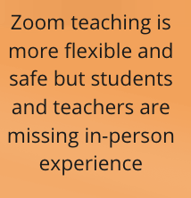
Tensions, Contradictions, Surprises
Notes:
OUt of all tensions and contradictions
Tensions- yellow
Contradictions- orange (making time for self care/eating, how they spend free time ideal vs actual)
Surprises- blue (FOMO with technology notifications, news and in person experiences, children motivate change)
Outstanding Q:
Why do women and mothers feel they need to sacrifice taking care of themselves, doing things that make them feel happy, and basic things like eating for their work or family?
Inference:
It’s difficult caring for kids and pets at home
_______________________
interviewee only leaves work once she’s completed everything and yet interviewee finds herself not getting enough sleep
Tamara said an ideal day wouldn’t include much screen time and yet she uses her phone mostly for social media which is more so recreational than necessary
Mothers often neglect their own needs and put others first but this negatively impacts them and then comes back to impact the family
Zoom teaching is more flexible and safe but students and teachers are missing out on a richer educational experience
The working women we interviewed said the struggle to make time to eat during day but it’s okay because they love their job
Surprises Maria:
Added responsibilities working from home
FOMO when her students return to the classroom
Zoom 1-1s feel more personal since faces can be seen
Surprises Tamara:
Her children helped motivate her to get off welfare and start her salon
Believes that women, especially mothers should prioritize self-care
Feels a responsibility to give back to her community
Doesn’t like interacting with technology a lot

Slide 19
Summary: Insights and Needs
Insight:
Insight:
Insight:
Need:
Need:
Need:
Women sacrifice meal time for productivity
Women find it is difficult to prioritize time for themselves
Women struggle to make free time restorative and meaningful
An opportunity to fuel without feeling inefficient
Motivated to prioritize to personal time in empowering ways
A way to carve out free time in their day

Slide 20
Summary
What we did
Learned Women Need:
Moving Forward
Interviewed four women on their behaviors, habits, and productivity, and changes due to COVID
More opportunities to fuel without feeling inefficient
A way to carve out free time in their day
Motivated to prioritize to personal time in empowering ways
Interview a more diverse group to get broader perspectives on habits, productivity, and behavior

